Slide 1
Density Functional Theory
Structure, electronic and magnetic properties of materials
Summary
Junfei Ding 13-Oct-20
Magnetic
Structure
Electronic

Slide 2
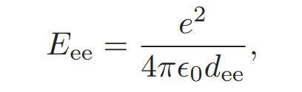
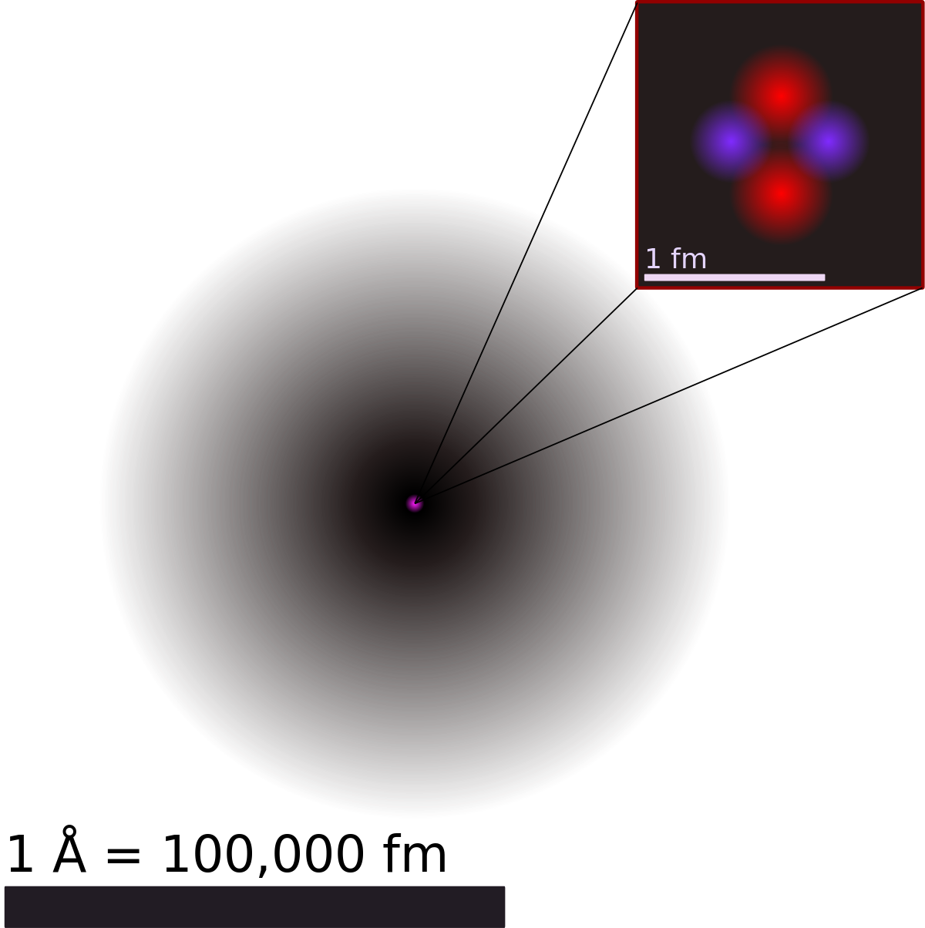
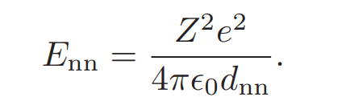
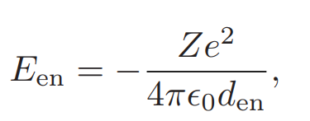
Materials= electrons + nuclei
Summary
Magnetic
Structure
Electronic

Slide 3

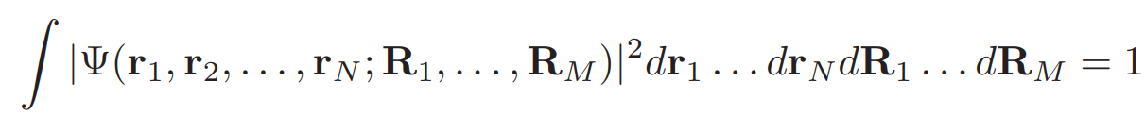


Many-body Schr$\ddot{o}$diner equation
Summary
Magnetic
Structure
Electronic

Slide 4
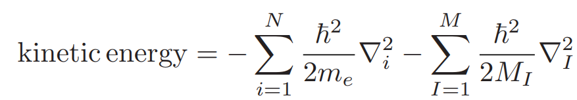
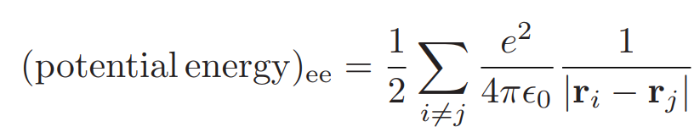
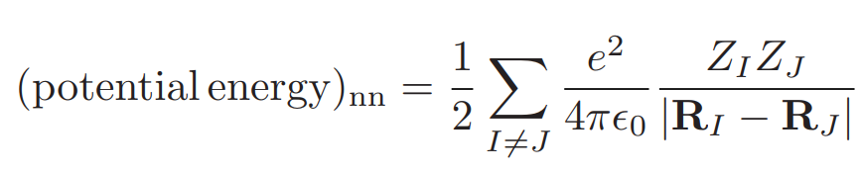
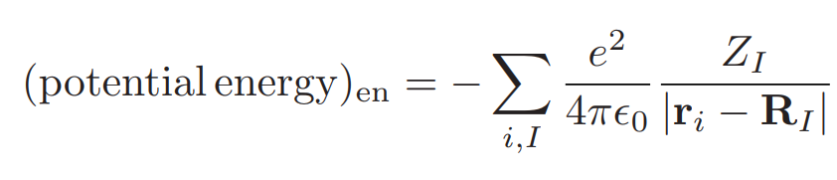
kinetic energy + potential energy
Summary
Magnetic
Structure
Electronic

Slide 5
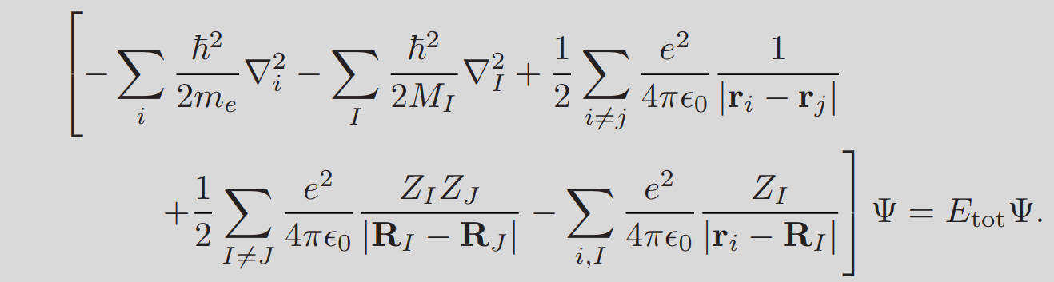
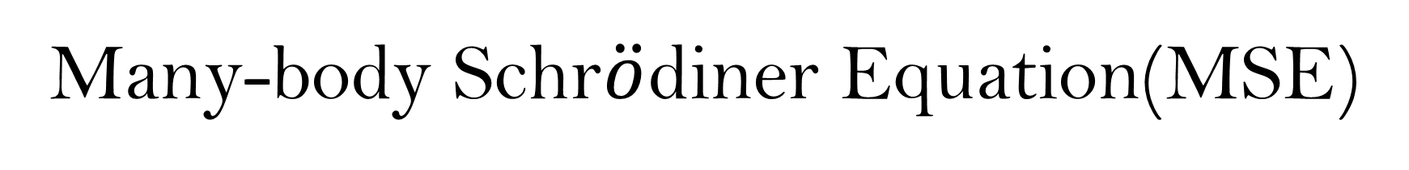
Many-body Schr$\ddot{o}$diner Equation(MSE)
Summary
Magnetic
Structure
Electronic
MSE is almost everything that we need to know in order to study the behavior of materials at equilibrium. If we were to be more rigorous, then we would include the time dependence, the interaction with external electromagnetic fields, and some corrections arising from the theory of relativity

Slide 6
Describe silicon by MSE
A possible strategy for solving the partial differential MSE is to discretize the space into a uniform mesh of points, and transform the problem into a linear system by using finite differences for the derivatives.
Summary
Magnetic
Structure
Electronic

Slide 7

Density Functional Theory
What’s the fundamental problem that DFT theory solves?
Summary
Magnetic
Structure
Electronic
Junfei Ding 08-Sep-2020

Slide 8

Finite-difference approximation
The derivative of a function f(x), defined by
$$f^{′}\left(x\right)=\lim_{h→0}\frac{f\left(x+h\right)−f\left(x\right)}{h}$$
a fairly reasonable approximation might be
$$f^{′}\left(x\right)≈\frac{f\left(x+h\right)−f\left(x\right)}{h},h≪1$$
This is known as an example of a finite-difference approximation, with h referred to as the step size.
Summary
Magnetic
Structure
Electronic

Slide 9

Finite-difference approximation
Recall that the Taylor series is defined by
$$f\left(x\right)=\sum_{n=0}^{∞}{\frac{1}{n!}{\left(x−x_{0}\right)}^{n}f^{\left(n\right)}\left(x_{0}\right)}$$
Now, expanding f(x + h) as a Taylor series of variable h, around the initial point x = $x_{0}$
$$f(x+h)=\sum_{n=0}^{∞}{\frac{1}{n!}(x+h−x)^{n}f^{(n)}(x)}=\sum_{n=0}^{∞}{\frac{1}{n!}h^{n}f^{(n)}(x)}$$
$$f(x+h)=f(x)+hf^{′}(x)+\frac{1}{2}h^{2}f^{′′}(x)+\frac{1}{6}h^{3}f^{′′′}(x)+𝒪(h^{4})$$
$$f^{′}(x)=\frac{f(x+h)−f(x)}{h}−\frac{1}{2}hf^{′′}(x)−\frac{1}{6}h^{2}f^{′′′}(x)+⋯$$
$f^{′}\left(x\right)=\frac{f\left(x+h\right)−f\left(x\right)}{h}+𝒪\left(h\right)$ first-order finite-difference approximation
Summary
Magnetic
Structure
Electronic

Slide 10

Finite-difference approximation
The second derivative
$$\begin{aligned}f(x+h)=f(x)+hf^{′}(x)+\frac{1}{2}h^{2}f^{′′}(x)+\frac{1}{6}h^{3}f^{′′′}(x)+⋯ \\ f(x−h)=f(x)−hf^{′}(x)+\frac{1}{2}h^{2}f^{′′}(x)−\frac{1}{6}h^{3}f^{′′′}(x)+⋯⋅\end{aligned}$$
Summing these together,
$$f(x+h)+f(x−h)=2f(x)+h^{2}f^{′′}(x)+𝒪(h^{4})$$
and rearranging to solve for $f^{′′}(x)$
$$f^{′′}(x)=\frac{f(x+h)−2f(x)+f(x−h)}{h^{2}}+O(h^{2})$$
Summary
Magnetic
Structure
Electronic

Slide 11

Euler method
$$f^{′}\left(x\right)=\frac{f\left(x+h\right)−f\left(x\right)}{h}$$
Suppose that we have an initial value problem
$$\frac{dy}{dx}=f\left(y\left(x\right),x\right),y\left(x_{0}\right)=y_{0}$$
$$\frac{y(x+h)−y(x)}{h}≈f(y(x),x)$$
Rearranging, this gives us
$$y(x+h)≈y(x)+hf(y(x),x)$$
Summary
Magnetic
Structure
Electronic

Slide 12
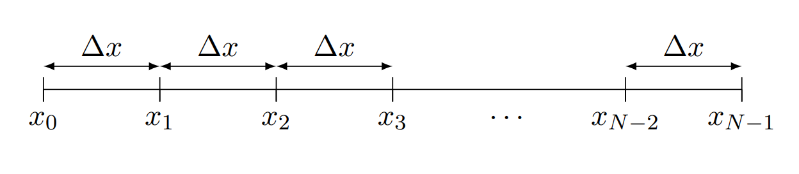

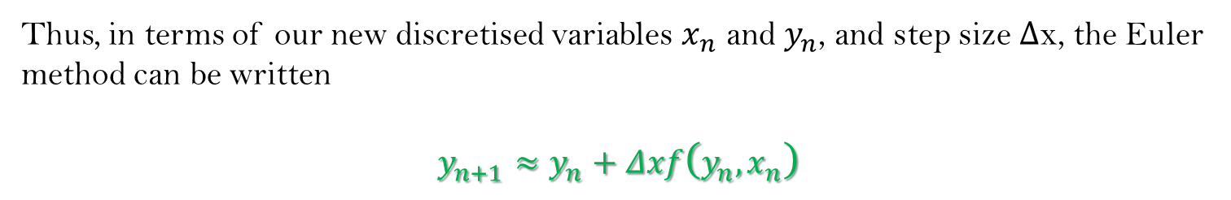
Euler method
Discretise the x-coordinate to produce a discrete x grid:
$$\begin{aligned}y_{0}&=y\left(x_{0}\right) \\ y_{1}&=y\left(x_{1}\right) \\ &⋮ \\ y_{N−1}&=y\left(x_{N−1}\right)\end{aligned}$$
Summary
Magnetic
Structure
Electronic
Thus, in terms of our new discretised variables $x_{n}$ and $y_{n}$, and step size Δx, the Euler method can be written
$$y_{n+1}≈y_{n}+Δxf\left(y_{n},x_{n}\right)$$

Slide 13

Euler method
$$y_{n+1}≈y_{n}+Δxf\left(y_{n},x_{n}\right)$$
Use the forward Euler method to solve the initial value problem $y^{′}$(x) = xy(x),
y(0) = 2 between 0 ≤ x ≤ 1.
To solve this numerically, let’s choose Δx = 0.01; this results in a grid of size N = (1 − 0)/Δx + 1 = 101.
Applying the Euler method, we get the iterative equation
$$y_{n}=y_{n−1}+Δx\left(x_{n−1}y_{n−1}\right)$$
Summary
Magnetic
Structure
Electronic

Slide 14
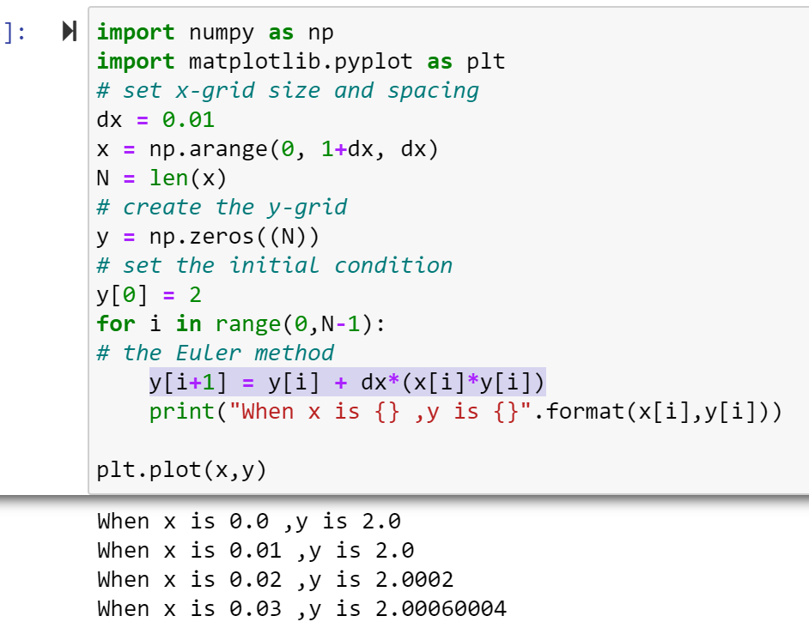
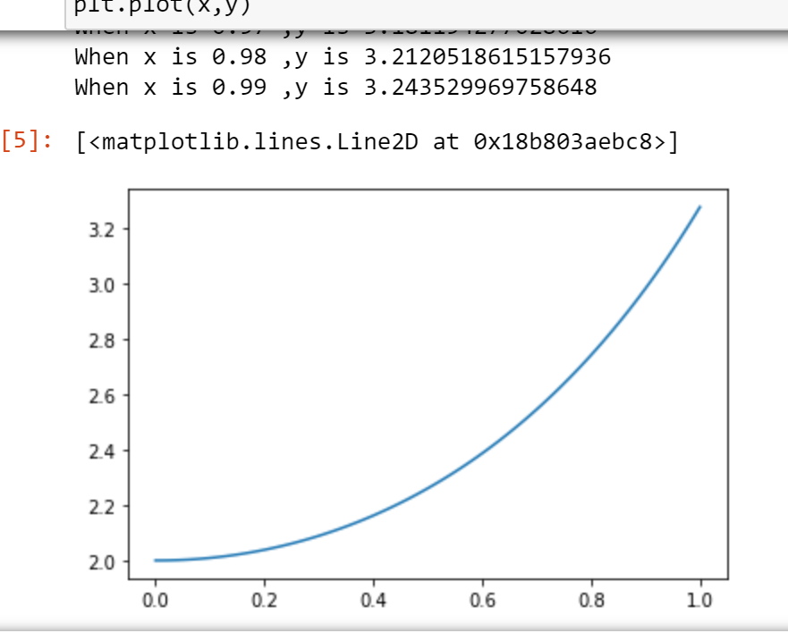

Euler method
$$y_{n}=y_{n−1}+Δx\left(x_{n−1}y_{n−1}\right)$$
Summary
Magnetic
Structure
Electronic

Slide 15
Many-body Schr$\ddot{o}$diner Equation(MSE)
Summary
Magnetic
Structure
Electronic
MSE is almost everything that we need to know in order to study the behavior of materials at equilibrium. If we were to be more rigorous, then we would include the time dependence, the interaction with external electromagnetic fields, and some corrections arising from the theory of relativity

Slide 16
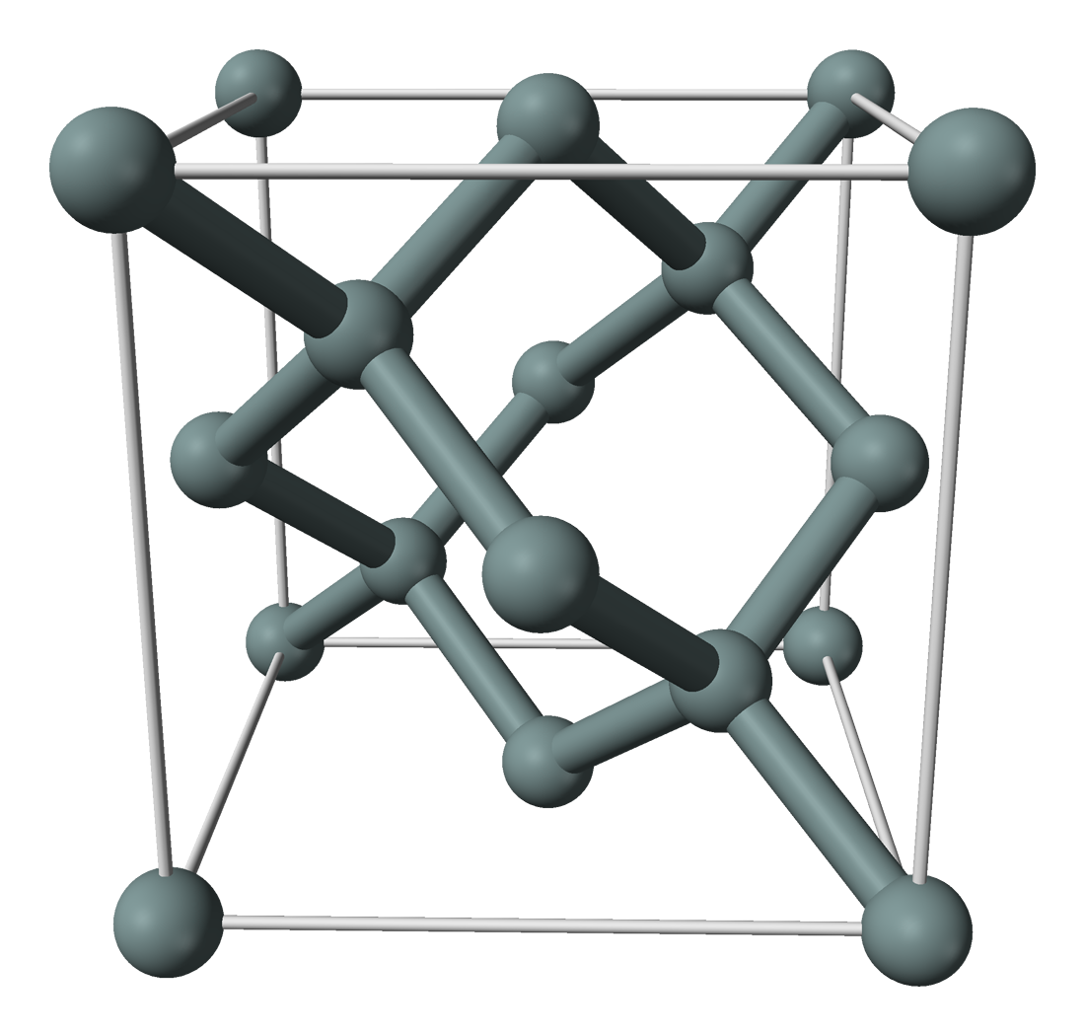
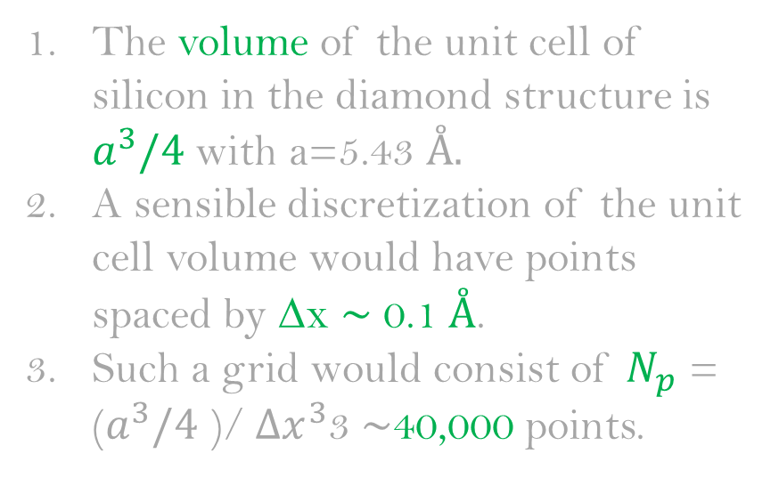
Describe silicon by MSE
The volume of the unit cell of silicon in the diamond structure is $a^{3}/4$ with a=5.43 $Å.$
A sensible discretization of the unit cell volume would have points spaced by ∆x ∼ 0.1 $Å$.
Such a grid would consist of $N_{p}$ = ($a^{3}/4$ )/${Δx}^{3}$3 ∼40,000 points.
Summary
Magnetic
Structure
Electronic
This Photo by Unknown Author is licensed under CC BY-SA

Slide 17

Describe silicon by MSE
Counting 4 valence electrons for each of the 2 silicon atoms in the unit cell, as well as the two nuclei, i.e. N + M = 10 particles, the complete specification of a quantum state$Ψ_{si}(r_{1}…r_{8};R_{1},R_{2})$ would require $N_{P}^{N+M}∼{10}^{46}$complex numbers.
Performing matrix operations with arrays of this size is obviously impossible.
Summary
Magnetic
Structure
Electronic
Exponential wall
This Photo by Unknown Author is licensed under CC BY-SA

